Slide 1
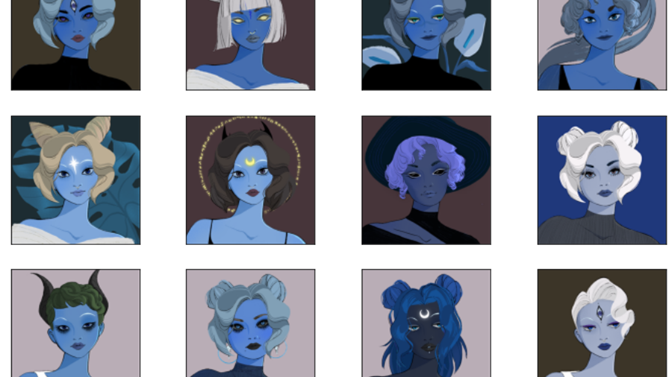
Analysis of NFT Transactions and NFT art similarity
Pavan KARNATI | Data Analytics and Visualization

Slide 2
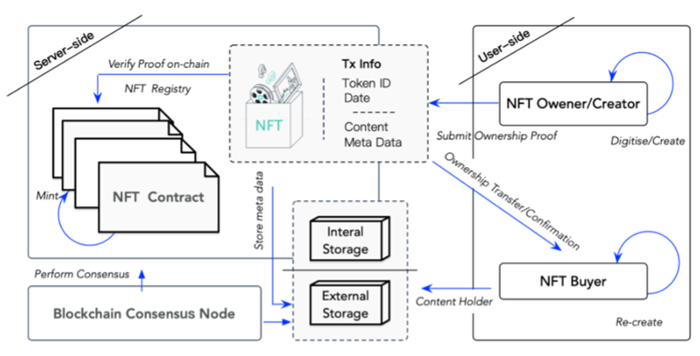
Literature Review
Blockchain and Bitcoin
Ethereum Protocol
Smart Contracts and Smart Ledgers
Token Standards
NFTs

Slide 3
Datasets
Ethereum NFTs Transactions Dataset
NFTs Art Dataset

Slide 4
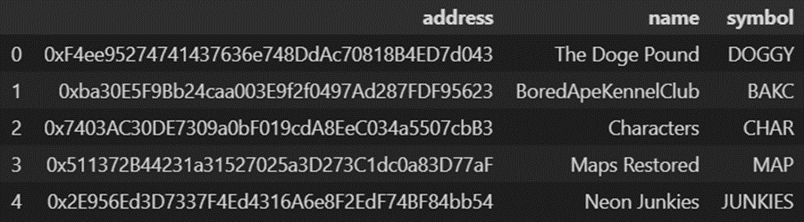
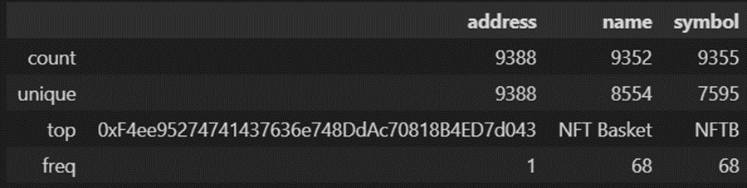
Level 1 – Descriptive Statistical Analysis
9388 NFT Collections.
Repeated symbols and names.
Mode of minters address belongs to collection ENS
Most transferred collections
sorare, ens, artblocks, foundation and CryptoKitties.

Slide 5
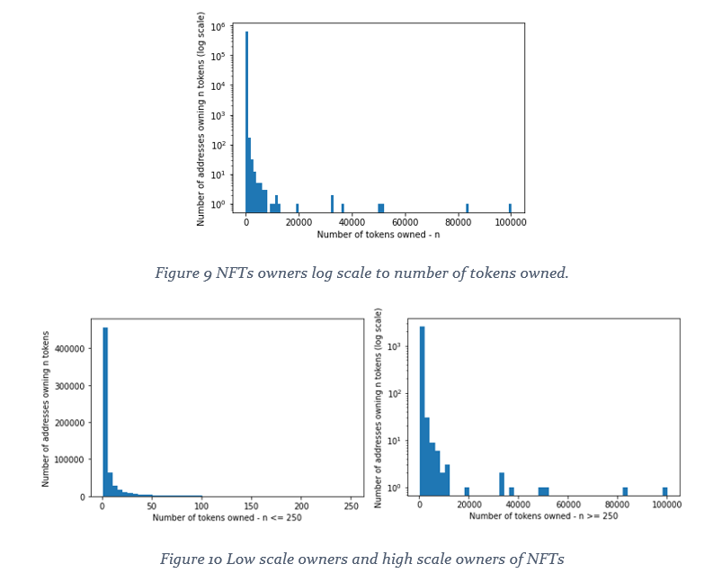
Level 1 – Descriptive Statistical Analysis
Most owners own just a small number of tokens.
Very few own 100,000s of tokens which are NFT marketplaces like opensea.
Low Scale owners ( owners with less than 250 tokens ) are a majority.
High Scale owners are rare

Slide 6
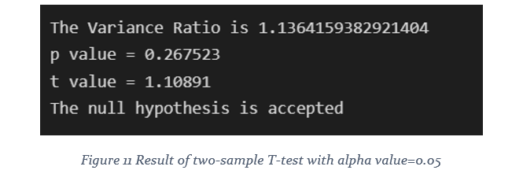
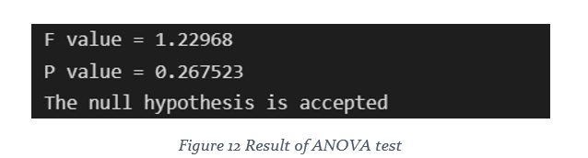
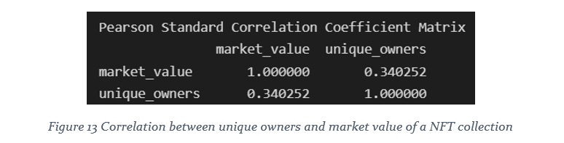
Level 2 – Inferential Statistics
the owners of one popular NFT collection BoredApeYachtClub(BAYC) and smaller NFT collection called WyldFrogz(WF) are statistically comparable
Unique owners are somewhat correlated to the market value of the NFT collection.

Slide 7
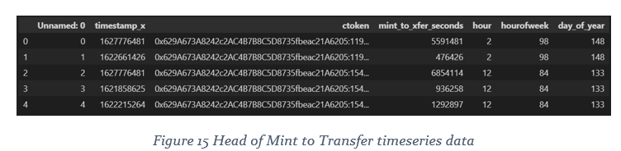
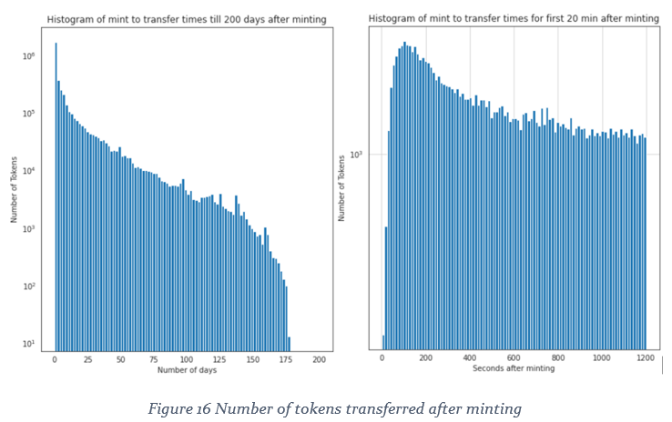
Level 3 – Machine Learning
Linear regression between Unique owners and Market Value not feasible.
Most tokens are transferred within first few days of minting.
Popular NFT tokens are transferred within first few minutes of minting.

Slide 8
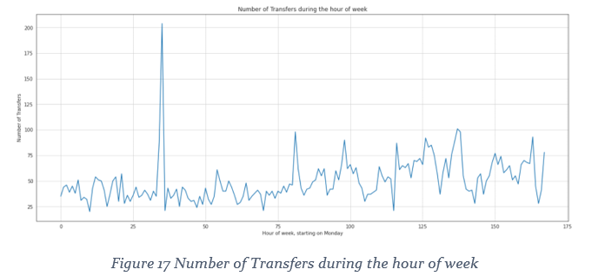
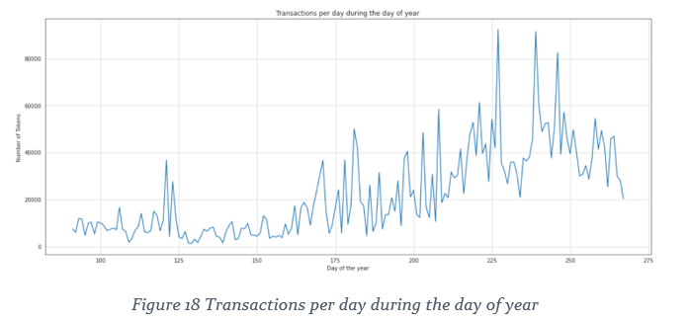
Level 3 – Machine Learning
Best time to mint a token is between Friday and Saturday.
Overall NFT transfers have decreased after 3rd quarter.

Slide 9
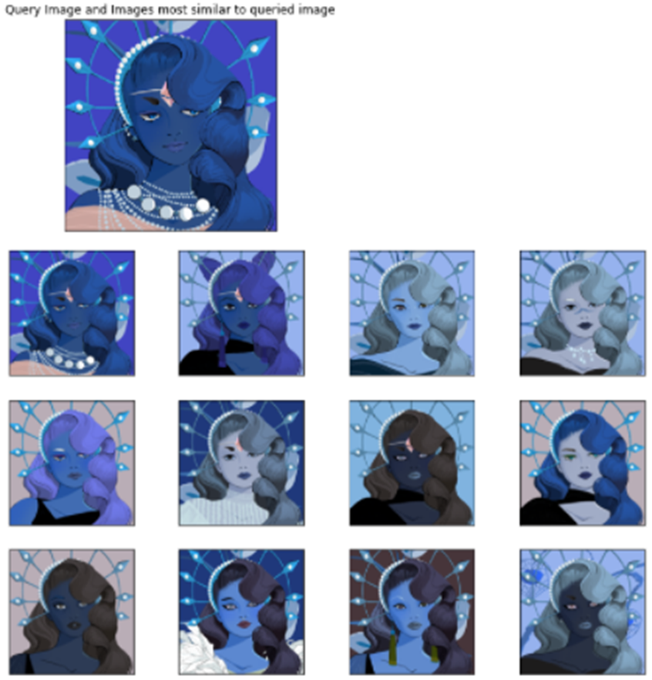
Level 4 – Deep Learning
Extract features of images using Xception model.
Train a deep learning model.
Use cosine similarity to get K nearest neighbors of a queried image.
NFT tokens gain value with rarity.

Slide 10
Thank you
Presentation Link - https://1drv.ms/p/s!Aqx1dxfj_eeAiDPZNtFMlFMGjjY_?e=pWc96g

